Slide 1
Statistics In FRC (Practical)
Caleb Sykes
Presented at TRI in June 2019

Slide 2
Who am I?
Caleb Sykes
Student, FRC 2052 (2009-2013)
Mentor, FRC 4536 (2013-2017)
Has played around a lot with FRC statistics (2016ish to present)
B.S. in Electrical Engineering from the University of Minnesota
M.S. in Electrical Engineering from the University of Minnesota
Currently unemployed (June 2019), if you have a job opening let me know ☺

Slide 3
Definitions
OPR: Offensive Power Rating, I use it interchangeably with calculated contribution because I hate the name OPR
Elo: When I talk about Elo, I’m referring specifically to the Elo model I have developed and published. Calculated contributions have been around long enough to have become standardized, but since Elo is still very new to FRC, there exist alternate models.
Variance adjustment: Behaving in ways that increases or decreases risk-reward opportunities

Slide 4
How do we calculate these metrics?
You should check out my other presentation for a better answer
Calculated contributions are kind of like averages, but better since they incorporate how good your partners are.
Elo is an iterative strength estimator where you gain or lose points each match depending on if your alliance overperformed or underperformed expectations.

Slide 5
Why use metrics at all, shouldn’t we just scout?
Obviously, yes you should still be scouting
The insights that you can get from non-scouting metrics are nowhere near developed enough to completely supplant traditional scouting metrics. That said, there are shortcomings in traditional scouting that can be supplemented with algorithmic metrics.
As an example, how do you prepare for a match when you are early in the event and haven’t seen teams play yet? Particularly if it’s the first event of the season or if no match video exists of a team’s prior event?
The key here isn’t to waste time trying to figure out which methodology is strictly better than the other, but to look at the strengths and shortcomings of both and to choose the right tool for the task at hand.

Slide 6
Elo, OPR, CCWM, DPR, WMPR
Elo and OPR have the most predictive power of any general “team strength” metric. The other metrics are not worth using for this purpose in my opinion. The average of the Elo and OPR Win Probability predictions are better than either separately.
DPR is pretty close to noise. So close in fact that it’s not even intuitive to me if higher or lower DPRs are better, and it may even depend on the year.
Because of relationship CCWM = OPR – DPR, if we rewrite DPR as “noise”, we get CCWM = OPR + noise. So in my opinion, CCWM is essentially just an inferior version of OPR because of the extra noise.
WMPR (Winning Margin Power Ranking) has even less predictive power than CCWM. If you haven’t heard of this metric, don’t worry, I don’t think you are missing much.

Slide 7
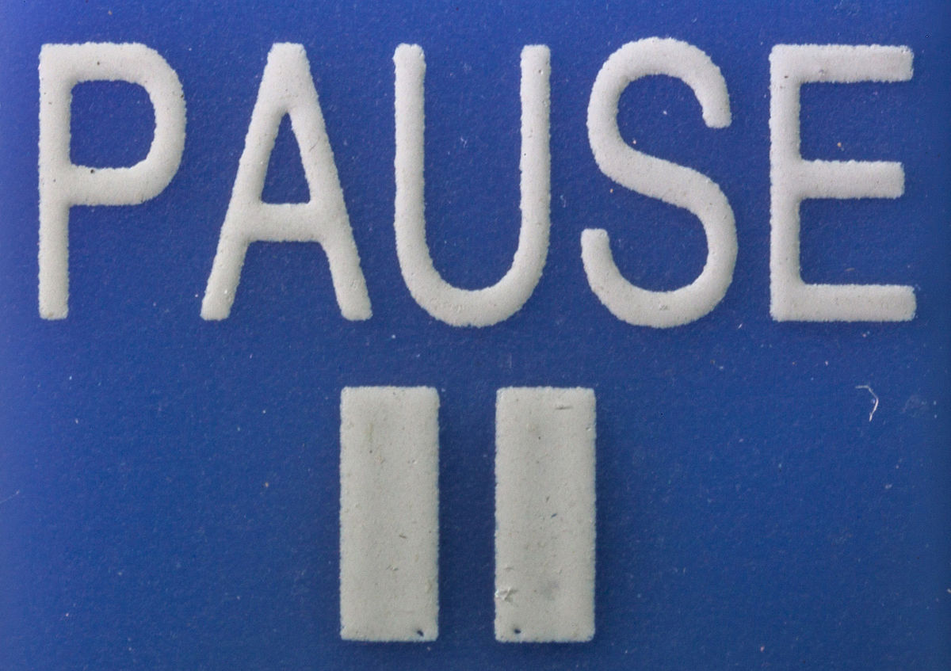
Pause for questions

Slide 8
Match strategy
The thing people tend to focus on the most in match strategy is how to get your alliance to score the most average points. And with good reason! My advice broadly for this is:
  Try not to get in each others way, especially if there is defense
  Get everyone to spend as much time as possible doing what they are best at. Think about opportunity costs, even if a team is better than you at everything, that does not mean they should be doing everything.
  Look at resource management (loading stations, game pieces, starting locations, ending locations) and determine how to allocate these best among teams
However, there’s another aspect of match strategy that I also believe to be important that frequently gets overlooked, which I’m going to call “variance adjustment” (if there’s an existing name for this let me know, I just made this one up). If I can get you to take one thing away from this presentation, it is that you should be thinking about variance in addition to averages when you are choosing strategies.

Slide 9
Variance adjustment
If you are the favorite in a match, you want low variance. There are less ways for the opponent to win if everything is under your control.
If you are the underdog in a match, you want high variance. There are more opportunities for upsets when things are “out of control” because although you can’t necessarily control them, your opponent can’t either.
If you are roughly equal with the opposing alliance, the variance doesn’t matter much. So you should just be focusing on getting a high average score.

Slide 10
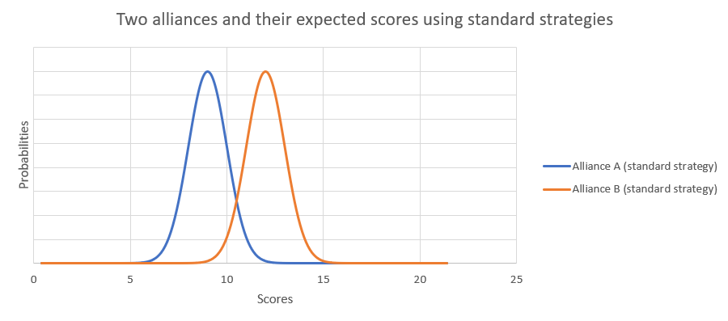
Variance adjustment

Slide 11
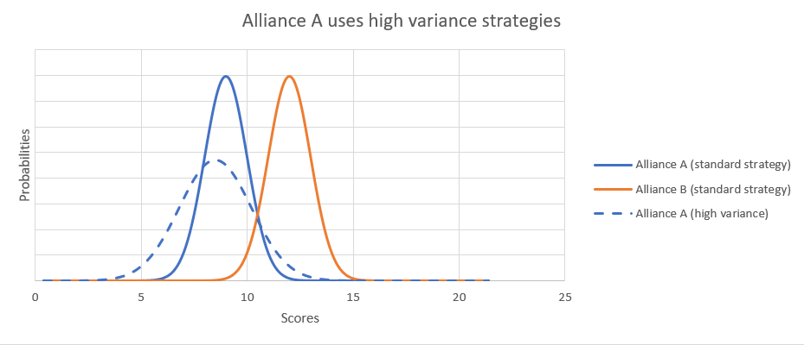
Variance adjustment

Slide 12
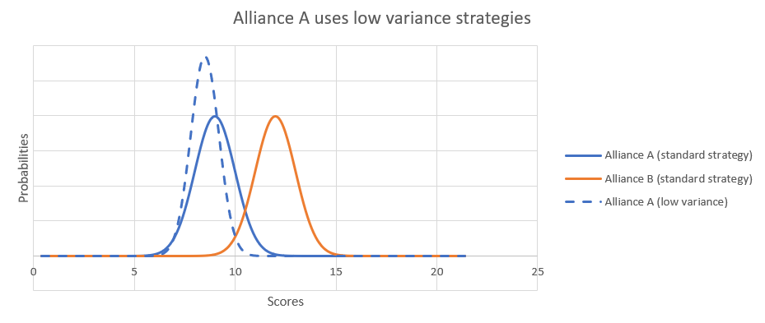
Variance adjustment

Slide 13
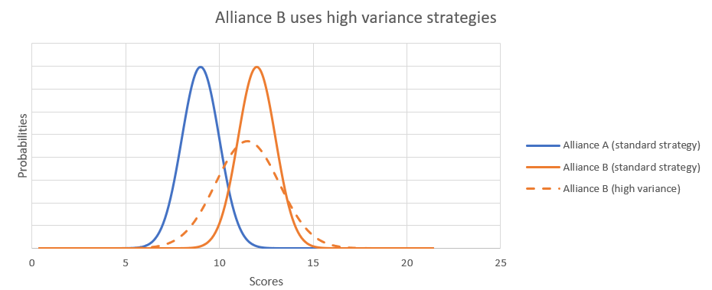
Variance adjustment

Slide 14
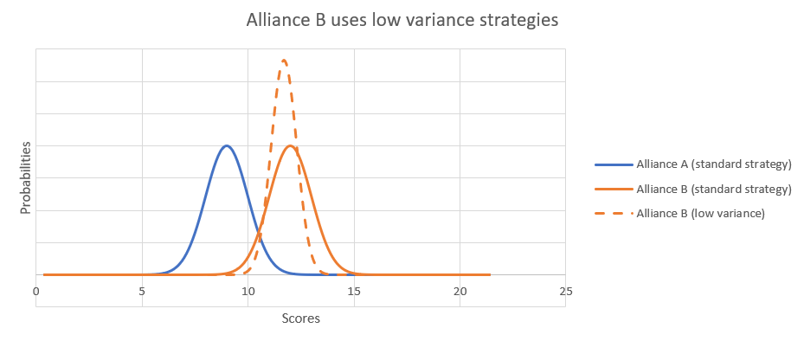
Variance adjustment

Slide 15
Match strategy
“Variance adjustment” in pro sports
High Variance Strategies
Low Variance Strategies
NFL: Lots of passing, spiking the ball to stop the clock, blitzing, timeouts, onside kicks, hail marys
NBA: Shooting 3 pointers, shooting fast, intentional fouling, timeouts
NHL: Pulling the goalie, lots of shots, more aggressive play risking fouls
NFL: Lots of running, letting the play clock go low, keeping safeties deep on the field, not using timeouts, squib kickoffs, this craziness
NBA: running down the shot clock, not using timeouts, trying harder not to foul
NHL: Lots of passing, punting the puck deep toward the other side, less aggressive play to avoid fouls.

Slide 16
Can you think of any ways to get high variance in frc matches? Low variance?

Slide 17
Match Strategy
“Variance adjustment” in FRC
High Variance Strategies
Low Variance Strategies
Untested/minimally tested auto modes
Off-meta strategies (e.g. send your best scorer over to play defense)
Giving yourself 5 less seconds to line up for the endgame
Add on that untested mechanism and give it a whirl
Aggressive defense
Risk some fouls (e.g. hold the pins a bit longer, stay right on the edge of the protected zone when defending)
Switching up game plan in second playoff match
Very reliable, but slower auto modes
Sticking closely to the “meta”
Giving yourself 10 extra seconds to line up for the endgame
Tweak as little as possible about your robot before the match
Limited/no defense
Be hyper-aware of fouls
Repeatedly choose the same strategy in playoffs

Slide 18
When to adjust your variance
In the pro sports I mentioned, teams begin seriously adjusting the variance in the last few minutes of the game. Since FRC Matches are less than 3 minutes long, it would be wise for you to go into matches with an idea of how much variance you want.
Obviously, there should be a bit of on-the-fly variance adjustment by the coaches during the match. But considering how chaotic matches already are you should have some kind of guideline.
Enter win probabilities. Before entering the match, you should use whatever tools at your disposal to understand if you are the underdogs or the favorites in the upcoming matches, and by how much.
You should also know what your goals are for the match (Win, maximize RPs, get at least X RPs, etc…) and take that into consideration. Remember, in addition to winning/losing, you also have to consider RPs.

Slide 19
How to make win probabilities
Win probabilities are not the only thing you can use to determine if you want high or low variance, there exist other useful alternatives. For example, you could predict the scores of both teams and look at how big the expected winning margin is. Likewise, you could give each alliance some kind of overall “rating” and look at how big the gap is between you.
Since I like probabilities when coaching, I will generally first do one of the latter 2 options above, and then plug that “difference” into the following formula:
WP = 1/(1+10^(d/s)) where:
  WP = Win Probability
  d is the difference in skill or expected score between your alliances
  s is some kind of scale factor you must experimentally determine. It can be thought of as the difference in skill between the teams required for the stronger team to win 10 times more than the weaker team.
    For Elo, s = 400
    For my OPR calculations, I use 2.0*(standard deviation of week 1 scores), or about 34 in 2019
    If you use scouting data to make a score prediction, I would generally recommend 1.6*(standard deviation of week 1 scores), or about 25 in 2019. Higher if you have less data or bad data, lower if you are feeling very confident in the predictions later in the event.

Slide 20
General game plans
When I did drive coaching, I usually used Elo/OPR to make a match prediction, and later at the event I would take scouting data and adjust the prediction 20% or so based on what that told me. I would then pick a general game plan. Specifics varied a lot depending on the match and our teammates, but you should have an estimate of what will happen even before you begin planning with teammates.
Here are the game plans I roughly followed:
  Strong favorites (WP > 70%)
    Low variance strategies
    Plan to focus more on bonus RPs (since W/L RPs are mostly decided)
  Underdogs (WP < 30%)
    High variance strategies
    Plan to focus more on bonus RPs (Since W/L RPs are mostly decided)
  Roughly even with opponents (30% < WP < 70%)
    Just focus on average points maximization and don’t worry about variance
    Plan to focus more on getting W/L RPs than bonus RPs because W/L is worth 2 RPs

Slide 21
Pause for questions

Slide 22
Scouting and Alliance selection
Whenever possible, if the FMS provides robot-specific scoring breakdowns, you should incorporate those into your scouting. Generally these are auto mobility and endgame points. You can copy those right out of my event simulator if you want or build your own interface to FIRST’s or TBA’s APIs.
By the time you get around to alliance selection, hopefully you have enough good scouting data to let that drive your alliance pick, however, you can still gain some insight from the non-scouting statistics.

Slide 23
Comparing CCs to scouting data for Additional insights
Comparing calculated contributions directly to your scouting data for related categories can frequently provide some interesting insights. I tend to estimate the kind of “uncertainty” around a specific calculated contribution value at about 10%, and values close to 0 can just be thought of as 0.
With the above in mind, don’t get too hung up on differences, but I like to take a look at the 5-6 teams that have the biggest differences between both systems. Such teams will often be over or under rated by your scouting data because the impact the team has on the field (positive or negative) is not fully captured by your scouting methodology. Examples:

Slide 24
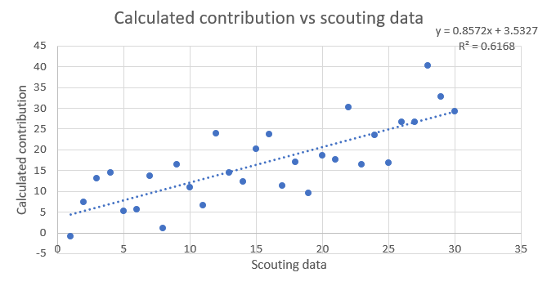
Visual inspection

Slide 25
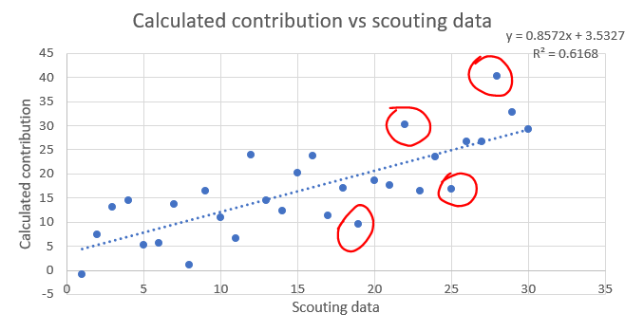
Visual inspection

Slide 26
Comparing CCs to scouting data for Additional insights
Comparing calculated contributions directly to your scouting data for related categories can frequently provide some interesting insights. I tend to estimate the kind of “uncertainty” around a specific calculated contribution value at about 10%, and values close to 0 can just be thought of as 0.
With the above in mind, don’t get too hung up on differences, but I like to take a look at the 5-6 teams that have the biggest differences between both systems. Such teams will often be over or under rated by your scouting data because the impact the team has on the field (positive or negative) is not fully captured by your scouting methodology. Examples:
  (2019) Calculated contribution to level 3 climb is much higher than team’s climb count according to scouting: Team is small enough to fit on the level 3 climb with another team.
  (2018) Calculated contribution to auto mobility is much lower than team’s auto mobility rate according to scouting: Team is demanding to start in a specific location, blocking other teams from using their normal autos.
  (2017) Calculated contribution to scored gears is less than the number of gears a team hands to pilots: Team is dropping gears at the loading station, blocking other teams from scoring their normal amount of gears.
  (2016) Calculated contribution to teleop boulders scored is much higher than 0 even though team doesn’t score boulders: Team has an amazing HP that can bowl all the way to the other side and also in-game the team will block opposing HPs from doing likewise.
These differences can frequently represent what in sports they refer to as “intangibles”
In order to understand the meaning of the differences, it is crucial that you understand exactly what both metrics represent, and what attributes of the game one or both are blind toward.

Slide 27
Variance adjustment in alliance selection
Just like with matches, you should use variance adjustment when selecting your alliance. The amount of variance you should aim to achieve depends on which alliance number you are and what your competitive goals are (win the event, wildcard, district points, etc…)
For alliance number, I and others have event simulators you can use to get a feel for which rank you and others will likely be. Or just wait until quals are over.
For competitive goals, you need to determine that before the event. For example, here are some possible goals:
  To got the most District Points on average
  To get at least X District Points (At later events district events, you can usually get a good prediction for what X is to get you a slot at your District Championship)
  Win the event
  Obtain a wildcard

Slide 28
What are some characteristics of high variance or low variance selections?

Slide 29
What are some characteristics of high variance or low variance selections?
High Variance
Low Variance
High peaks
One of the alliance members during the highest scoring qual match(es).
Half the team is scrambling around the pit working on the robot
Alliances coming up to you asking you to rewatch/rereview one specific match of theirs.
Something big and bad happens to robot in their last/second to last match
Some kind of specialty feature that could only demonstratably work during 1-2 matches, but worked well
Consistent performance
All/most matches have an above average score for the event
No one working on their robot during alliance selection
Alliances coming up to you saying “we never missed X” or “we only had one malfunction when doing Y all event”
Never is dead during a match
Can explain to you exactly why something went wrong the 1 or 2 times it did, and how it has since been fixed and tested.

Slide 30
Pause for questions

Slide 31
Elo vs OPR
Elo
OPR
Slightly more predictive power
Units can be difficult to interpret
Has a different value after each match, so at any point in time a team only has one “current” Elo rating
Ad hoc mess designed for predictive power (empirical basis)
Zero-sum in season
Slightly less predictive power (I take an average of Elo and OPR predictions in my simulator for best results)
Units of points, so much easier to interpret
Must be calculated on a set of matches (usually the entire season or one event), as such a team will have multiple OPRs depending on the set of matches
Strong mathematical foundation (theoretical basis)
Not zero-sum

Slide 32
How good of predictions can we make?
The alliance with the higher average Elo will win about 72% of the time, although it varies depending on the year
OPR predictions are correct about 1-2% less of the time than Elo

Slide 33
How good of predictions can we make?
Roughly, here are my estimates of how good you can get predictions in FRC, obviously these are year dependent, but I think these are in the ballpark:
Simple algorithms using only match scores – 75%
Advanced algorithms using detailed score breakdowns – 80%
Algorithms using scouting data – 80%
Human predictions from someone who watches a lot of matches – 80%
Human predictions from someone who watches a lot of matches and has detailed scouting data on hand – 85%
90% and higher - Not possible on a large number of matches

Slide 34
Other uses of statistics
Event simulation
Global rankings of teams
Determining “schedule strengths”
Predicting awards
Finding obscure contributors to match results (time between matches, alliance color, alliance station assignment, etc…)

Slide 35
Miscellaneous things I’ve learned
Across both robot performance metrics and Chairman’s strength metrics, I’ve found that teams revert toward the mean about 20% between each season. Meaning each team has a “half-life” of around 3 years. This shouldn’t be too surprising given how much churning there is of students, but still interesting that this arises from modeling.
If you have multiple data points for a team across different events, using the maximum value tends to provide better predictive power than the most recent value.
The predictive powers of Elo/OPR fluctuates a fair amount year to year. There exist lots of “improvements” to these metrics that help predictive power a lot in one year, but do nothing or even decrease predictive power in following years. Examples include:
  Weighting the strongest team’s rating more heavily
  Trying to incorporate bonus RPs
  Adding non-linearities to the Elo-update formula (logarithms, bonuses for winning, geometric instead of arithmetic means)

Slide 36
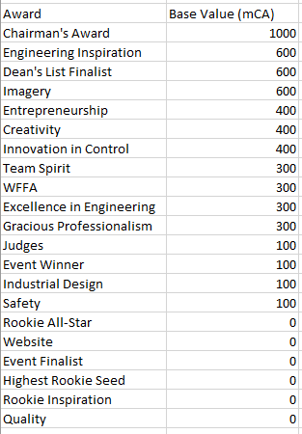
Miscellaneous things I’ve learned
For Chairman’s predictions, here is the relative value of each award for winning Chairman’s in the future:

Slide 37
Future Developments (theoretical and practical) that I’m planning to dive into eventually
A more advanced Elo that requires much more tuning at the start of each season, and to incorporate detailed score breakdowns
Elo-like iterative metrics for bonus RPs
Diving into the Zebra DART data
More and better awards predictions
Alliance selection predictions

Slide 38
Rant about the name “OPR”
The name OPR is really awful, so I prefer to use “calculated contribution”.
Offensive – This word is obsolete
Power – This word is meaningless
Ranking – This word is just wrong, at least try to use “Rating” instead

Slide 39
That’s all folks
Feel free to reach out to me for any questions or comments on Chief Delphi or by email: calebsyk@gmail.com
All of my work can be found on my GitHub: https://github.com/inkling16/
Scouting Database
Event Simulator
Historical Elos

